Slide 1


TABLESNAP
Table Detection
ASHLEY BREA, ASHLEY KIM, DIANE PARK

Slide 2

OVERVIEW
Originally wanted to be able to digitize handwritten data tables
To work our way there, we will first focus with table structure and object detection
Object Detection
Row and Column Detection & Mapping
Run OCR on the handwriting
Present a fully digitized data table
Notes:
ashley B
- originally wanted tp be able to digitize handwritten data tables, but given the previous feedback we'll work our way there in steps
- right now we'll be focusing on object detection, which is the detection of the table on a page

Slide 3
PREVIOUS SOLUTIONS
Deep learning for table detection and structure recognition: A survey
(Kasem et al., 2022)
Prasad et al. proposed CascadeTabNet, a R-CNN that identifies table areas along with individual table cell structures.
Siddiqui et al. created a network, DeCNT, a combined R-CNN and FPN that works on photos instead of just PDFs.
Notes:
diane

Slide 4
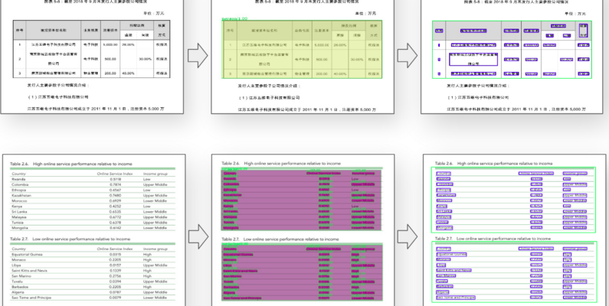

GENERAL TABLE DETECTION DATASET
Notes:
ashley b
- the data set we'll be using for this first step
-general table detection dataset that we found on kaggle

Slide 5
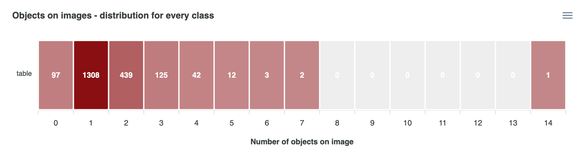

DATA EXPLORATION
A total of 2029 samples consisting of mixed file types, e.g. PNG, JPG, etc.
However we only want to use the samples with 1 table per page, which reduces the set to 1308 samples
The dataset is compiled of the train_annotated.csv and train_folds.csv, and train.csv
Notes:
ashley b
- consists of around 2,000 samples, which are images containing tables
- the amount of tables on an image ranges, but for our first step we want to focus only on samples with just one table per image
- compiled of 3 .CSV files

Slide 6
DATA CLEANSING
Using train_annotations.csv and train_folds.csv
train_annotations.csv: boundingbox values in a 4-tuple
train_folds.csv: number or tables found in image
Only want to focus on images with 1 table
Filtered data within train_folds, then within train_annotations
Left us with 1308 values for single tables
Notes:
annotations: same as train but has bbox in single array as well segmentation (4 corners of box)
ashley k

Slide 7

DATA PREPARATION
X: Image ID
Y: Bounding-Box values (x_min, y_min, bbox_width, bbox_height)
values are rescaled in terms of image width and height (not pixel value)
Split Data:
Training: 70%
Validation: 20%
Testing: 10%
Notes:
X: input data
Y: label
used bounding box to save memory (4 vs 8 values)
diane p

Slide 8
CHALLENGES
Identifying tables with no borders
Using a small dataset so our training may struggle to converge.
Different file formats: .jpg and .png files
Dataset does not include hand written text
Notes:
ashley k

Slide 9
THANK YOU!
ANY QUESTIONS ?
Notes:
Second Pres Feedback:
- get rid of data samples that dont align with our goals
e.g. get rid of samples that dont have boarders
- just focus on getting results basically
- check distribution in papers in terms of number of rows and columns
- can make "2d" to see the distribution, and do it after the splitting
- if too different, then it wouldnt make sense to shuffle the dataset (i think)...
FIRST PRES FEEDBACK:
- create sub tasks, to be able to track progress
- start with table structure and create a neural network thats able to create a table, and cell per image
- we could train our own model for handwriting,
- google LLM's with API connection ~ $10/month
Final data?:
front office sign in sheets

